Slide 1


Advance Health Directives (AHD)
Health professionals have legal responsibilities to ask about and enact the treatment decisions within the AHD.
Asking about AHDs is a part of goals of patient care discussions.
An AHD is a voluntary, person-led legal document completed by a competent adult that specifies the treatment(s) for which consent is provided or refused under specific circumstances.
When a valid AHD exists, it must be used to guide treatment if the person is assessed as lacking capacity to make their own judgements or communicate their decisions.
National Safety & Quality Health Services Standards (NSQHSS)
Guardianship & Administration Act 1990
Developed by: End-of-Life Care Program, Department of Health WA, Aug 2022.
Endorsed by: Deputy Director General, Clinical Excellence Division, Department of Health
Reviewed: Feb 2026

Slide 2

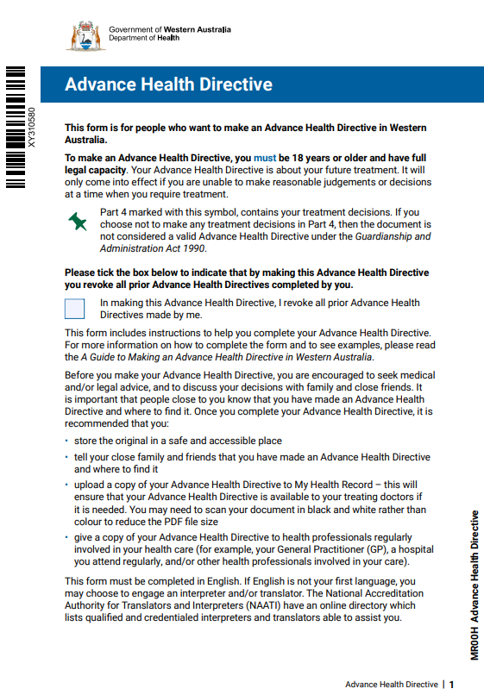
Parts of the AHD
Part 1: My personal details
Part 2: My health
Part 3: My values and preferences
Part 4: My AHD treatment decisions
Part 5: People who helped me complete this form
Part 6: Signature and witnessing
A valid AHD has the following components:
It is completed and signed by a competent adult, about themselves
It contains at least one treatment decision in Part 4
It is signed and witnessed.

Slide 3
What is my role with AHDs?
LOCATING YOUR PATIENT’S AHD
Ask about AHDs as early as possible
Ask your patient if they have an AHD.
If they are unsure or cannot communicate:
Ask their family/carer and/or GP
Check patient records AND My Health Record.
If they have an AHD, check that it still reflects their current thinking and choices.
Store and communicate
If patient has an AHD, raise a clinical alert and store AHD within patient’s record according to your site’s policy, procedure or guidelines.
Mention the AHD and other care planning documents/discussions in clinical handovers including:
Referrals
Discharge summaries
Outpatient correspondence
Check for patient consent to upload their AHD to their My Health Record and/or encourage and support them to do so.

Slide 4
What is my role with AHDs (cont.)?
CARING FOR PATIENTS WITH AN AHD
Link with Goals of Patient Care (GoPC)
Discuss content of AHDs/ advance care planning documents during GoPC discussions.
Ensure GoPC forms align with the patient’s AHD.
Enact & follow
If patient doesn’t have decision-making capacity, refer to their AHD and when relevant:
comply with the treatment decisions outlined within the AHD
provide care in accordance with their values and preferences
engage with the social work team to support families/carers with patient values and preferences
What if their AHD does not cover the treatment decision or they do not have an AHD?
refer to the Hierarchy of treatment decision-makers for the order in which you must consult decision-makers.
Review
Encourage patients to review their AHD when their health changes or at least every 2 - 5 years. NB. An AHD cannot be changed once it is completed (signed and witnessed). If the person still has decision-making capacity and wants to make a change, they need to make a new AHD.

Slide 5
How can I assist patients to make an AHD?
Explain how AHDs inform health professionals of a person’s values, beliefs and preferences should they lose the ability to communicate treatment decisions.
Provide advice to help patients make informed treatment decisions within their AHD e.g.
answer questions regarding concerns about their health
talk through options for future care.
Refer patients to:
services to support advance care planning discussions and complete AHDs:
Other departments or services within your hospital (e.g. ACP clinics)
Palliative Care WA 1300 551 704 for free community support:
advance care planning education workshops
Advance Care Planning Support Service for help with completing documents
healthywa.wa.gov.au/AdvanceHealthDirectives for more information and:
a copy of the AHD
the Guide to Making an Advance Health Directive in WA for instructions on completing AHDs
To learn more visit health.wa.gov.au/AHD
Department of Health WA Advance Care Planning Line: 9222 2300 ACP@health.wa.gov.au

