Slide 1


Recognising advance care planning (ACP) documents
A range of ACP documents are available for individuals in WA to record their values, preferences and treatment decisions.
They are used to inform care at a time when that individual is no longer able to make or communicate their own decisions.
! Your important role:
Understand the legal status of different ACP documents
Check their validity – raise any concerns with the individual, their family or the State Administrative Tribunal
Provide care in accordance with a patient’s ACP document if they can no longer communicate their decisions themselves.
Developed by: End-of-Life Care Program, Department of Health WA, Feb 2026.
Endorsed by: Deputy Director General, Clinical Excellence Division, Department of Health

Slide 2




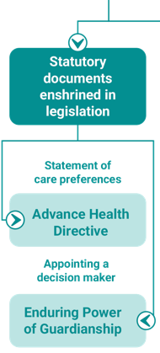
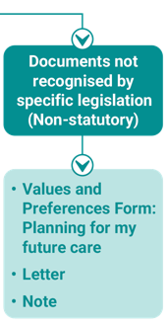
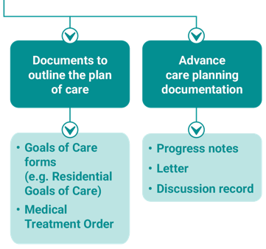
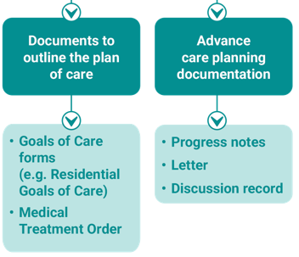
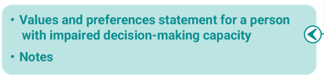
Types of ACP documents in WA
Statutory documents
Strongest, most formal way to record future care decisions
Must be signed and witnessed according to formal requirements
Must be followed in most situations
Non-statutory documents
Do not have the same legal status

Slide 3
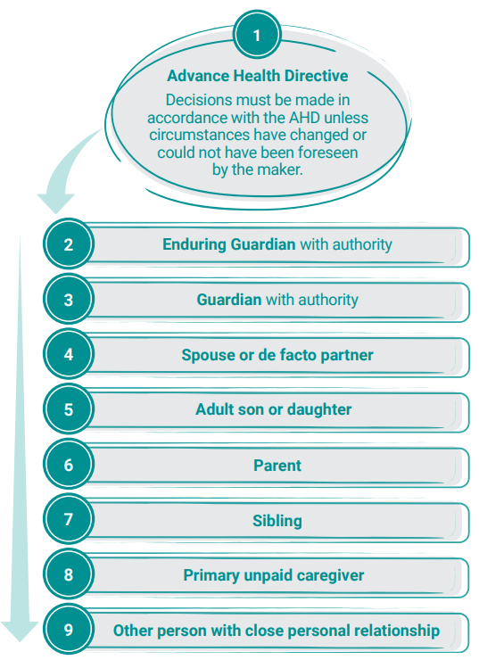
Hierarchy of treatment decision-makers
This hierarchy sets out the order you must follow when seeking a treatment decision for a person who lacks the capacity to make their own judgements or communicate their decisions.
Advance Health Directives are at the top of the hierarchy.

Slide 4
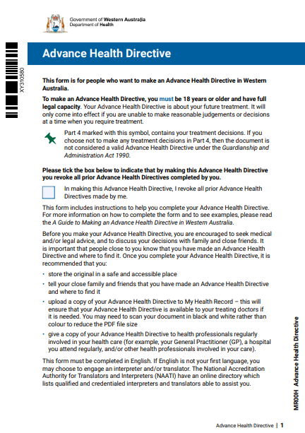
WA’s statutory ACP documents
Advance Health Directive (AHD)
A legal document that specifies the treatment(s) for which consent is provided, refused or withdrawn under specific circumstances.
Only comes into effect if:
the person becomes incapable of making or communicating their decisions.
it applies to the treatment the person requires.
An AHD cannot be used to:
request voluntary assisted dying
request active steps to unnaturally end life
request interventions that are not clinically indicated
request treatment that is medically futile
record wishes about organ and tissue donation - an AHD is ineffective after the person’s death.
Refer to the Guide to Making an Advance Health Directive in WA for step-by-step instructions.
Note – a person can have both an AHD and an EPG

Slide 5
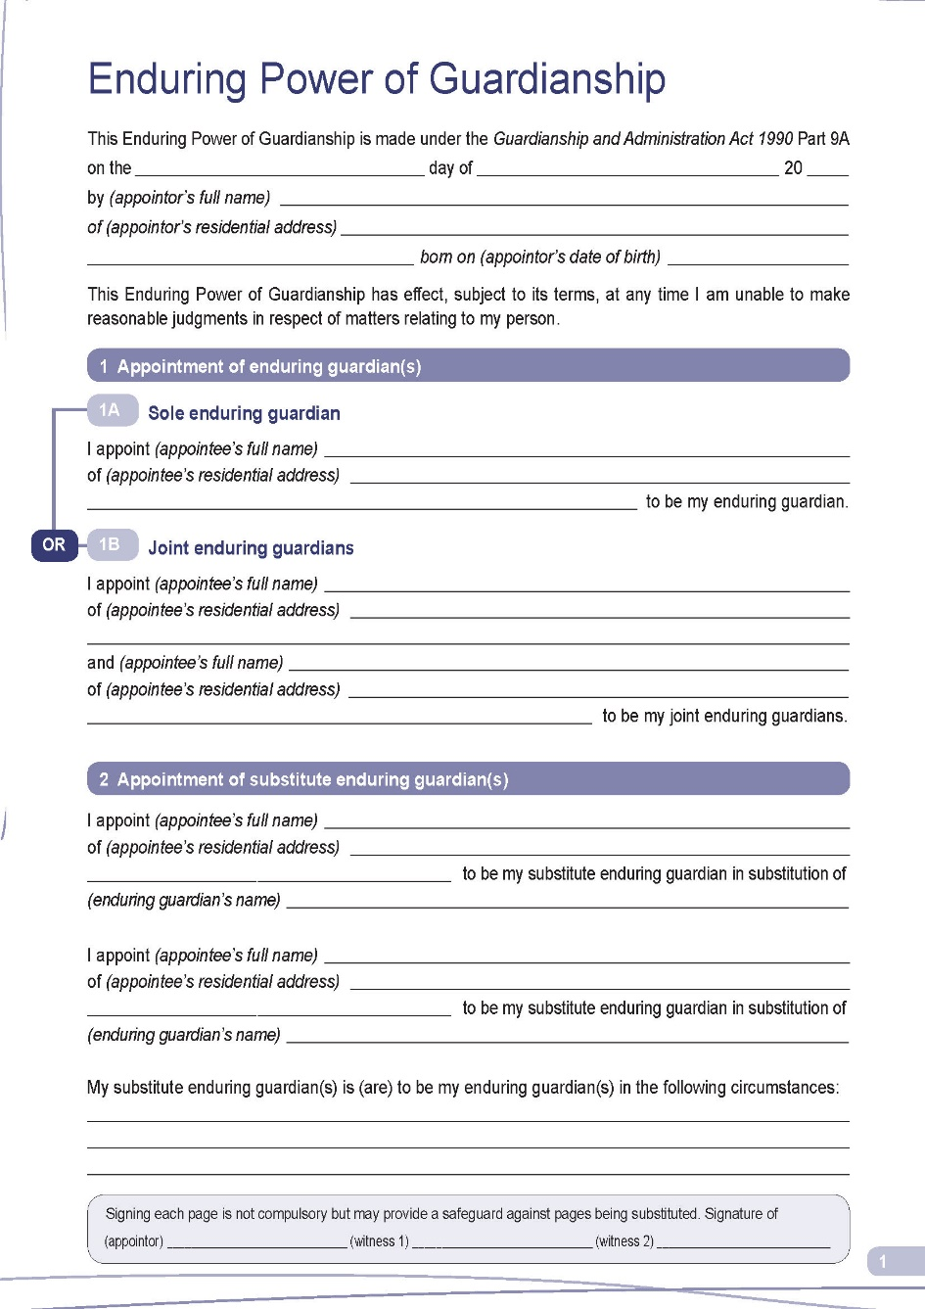
WA’s statutory ACP documents
Enduring Power of Guardianship (EPG)
A legal document in which a person nominates an enduring guardian to make personal, lifestyle and treatment decisions on their behalf in the event that they are unable to make reasonable judgments about these matters in future.
A person can appoint more than one enduring guardian
but the guardians must reach agreement on any decisions they make on the person’s behalf.
Note – An EPG is different from an Enduring Power of Attorney (EPA), which relates to financial and property matters.

Slide 6
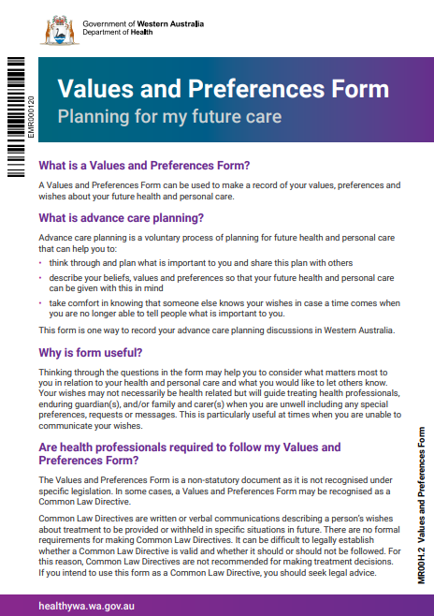
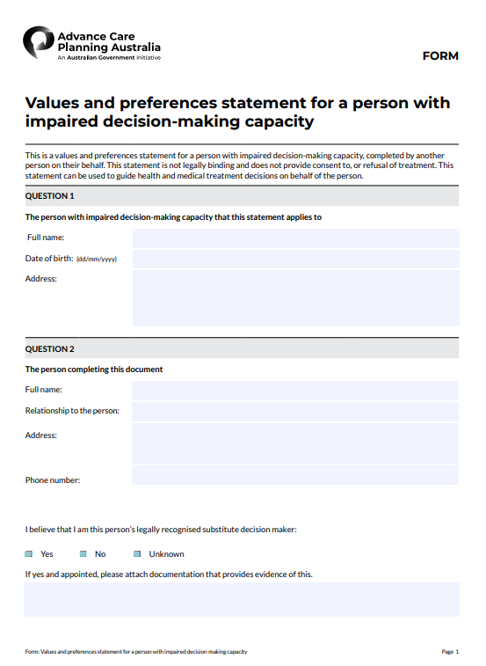
WA’s non-statutory ACP documents (used to guide decision-makers and health professionals)
Values and Preferences Form: Planning for my future care
Record of a person’s values and preferences (not necessarily health related) about future health and care.
Not for recording treatment decisions.
The questions are the same as Part 3 of the AHD.
In some cases, may be considered a valid Common Law Directive – although this is not the recommended format to make treatment decisions.
Values & preferences statement for a person with impaired decision-making capacity
Completed by a person’s recognised decision-maker(s) with whom they have a close relationship.
Cannot be used to give legal consent to, or refusal of treatment.
Should only be used if person does not have an AHD or Values and Preferences Form.
To order free documents and resources, or for more information: health.wa.gov.au/AdvanceCarePlanning
Department of Health WA Advance Care Planning Line: 9222 2300 ACP@health.wa.gov.au

